Slide 1
ISG Deal Registration FAQ

Slide 2
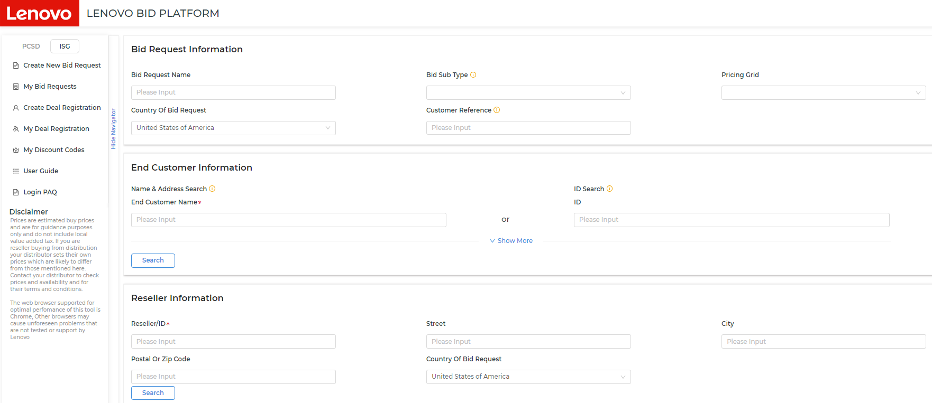
Lenovo ISG Deal Registration
Direct Access for Partners via LBPe platform
Access LBPe from the Lenovo Partner Hub
Deal Registrations are Account Based
Deal Registrations are approved by Lenovo EU Sales Reps
Deal Registrations provide better pricing but not exclusivity

Slide 3
ISG Deal Reg (DR) Basics
ISG Deal Reg is account based
1 Reseller and 1 Distributor hold the DR for the entire account
The named Reseller can change (but not add to) the named Distributor selection regardless of who created the DR (reseller or Disty)
DR validity is six months
An extension can be requested one time and if approved, it is valid for an additional 30 days
Investment Review
This occurs when a second deal reg is submitted for an account that already has a deal reg
The account team of the original (first) DR will need to approve another reseller to also hold a DR (dual deal reg)
ISG Product Selection
There is no need to select every ISG product category and it could slow down the approval process
All ISG products will receive deal reg benefits even if not selected in the original submission
3rd party Deal Protection
If the DR creator selects all ISG Software Products in the form, it will include 3rd party software vendors that have their own Deal protection process..
Any DR that has Nutanix Software selected will automatically be sent to Nutanix for their review once the DR is approved by Lenovo
DR will show Pending SAE (SAE = Strategic Alliance Enablement) and be subject to a 48-72hr SLA
If you have a deal reg that incorrectly has Nutanix sw selected and you need the DR rejected, send a note to isglbp@lenovo.com
Investment Review will be next to the account instead of Register Deal when another DR already exists

Slide 4
ISG Deal Reg Timeline – Existing End Customer account
If an existing end customer account is selected, SLA is 0-3+ business days
LBPe will evaluate the DR to see if eligible for auto-approval
If yes, DR is auto approved instantly
If no, DR will pass to Approver to review
Covered accounts will go to the assigned end customer account rep for approval (SLA: 1-3 days)
SMB uncovered accounts go to ISGLBP team for approval (SLA: 1 day)

Slide 5
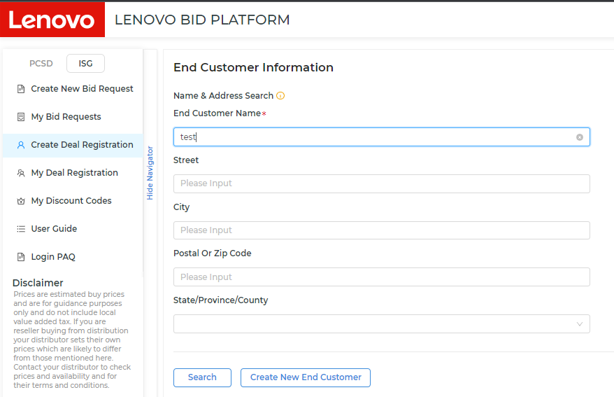
ISG Deal Reg Timeline – New End Customer account
If Create New End Customer Account is selected, SLA is 3+ business days
Data Steward (DS) team has 48hr SLA to perform due diligence (research to see if acct is truly new)
If yes, they will assign CRM ID and DR will pass to Approver to review
Covered accounts will go to account rep for approval (24hr SLA recommended but up to account rep)
SMB uncovered accounts go to ISGLBP team for approval (24 hr SLA)
If no, DS Team will reject and either reference the existing CRM ID that should be used or request more information

Slide 6
Additional FAQs
Why can’t certain accounts be deal registered?
Some accounts are blocked from deal registration for various business reasons
Send a note to isglbp@lenovo.com to check
The DR is approved but now it’s “Pending SAE”, what does this mean?
This means that Nutanix sw was selected and the DR has been routed to Nutanix for their deal protection review (48-72hr SLA).
Nutanix SW was incorrectly included in the DR and now I have to wait a few extra days for that approval, how can I have it rejected?
Please send a note to isglbp@lenovo.com
Note: The entire DR will be rejected in Lenovo’s system
How do I request an extension?
One extension can be requested if submitted prior to the deal reg expiring
From LPH, go to Sales -> Register an ISG Deal -> select My Deal Registration from the left nav bar -> either perform search or look in displayed results list
Hover mouse over blue Action button, select Extend and submit
If that Action does not exist, it means the DR is not eligible for an extension
How long is a DR extension valid for?
If approved, 30 days

Slide 7
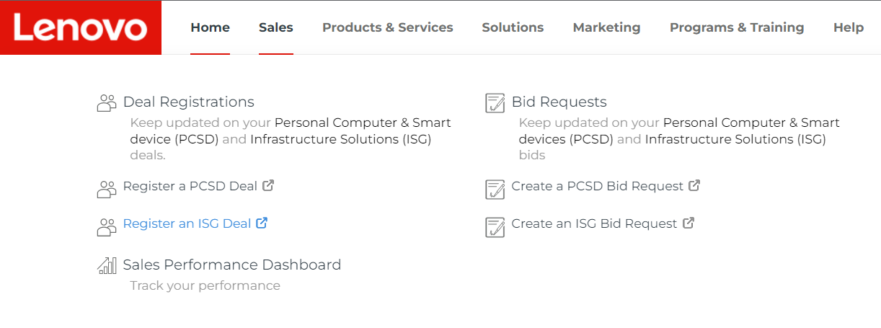
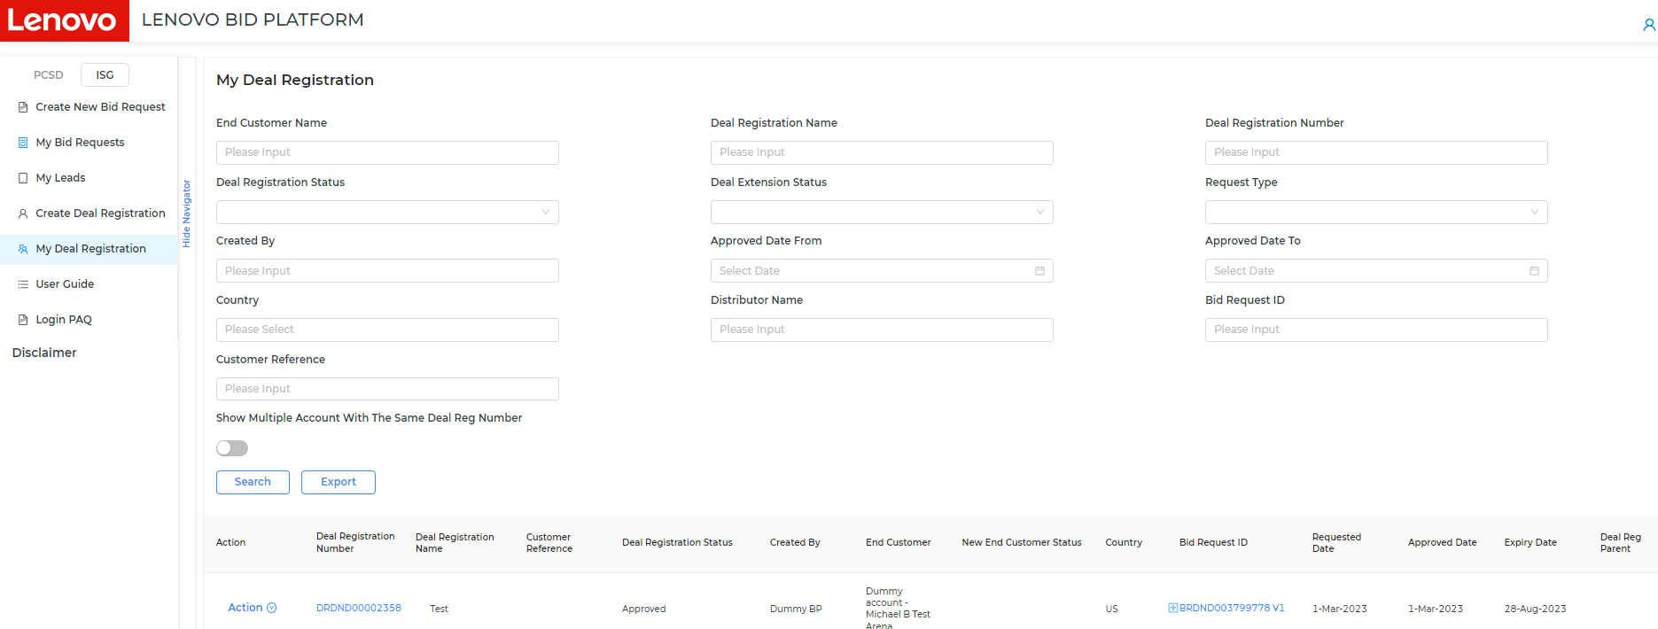
Additional FAQs continued
How do I change Distributors on an approved DR?
From LPH, navigate to Sales -> Register an ISG Deal -> select My Deal Registration from the left nav bar -> either perform search or look in displayed results list
Hover mouse over blue Action button, select Change Distributor and submit
Note: you may not add additional Distributors to a US deal reg, you can only change (remove & replace)

Slide 8
Questions?
isglbp@lenovo.com

Slide 9
Thanks

