Slide 1
Replibit

Slide 2
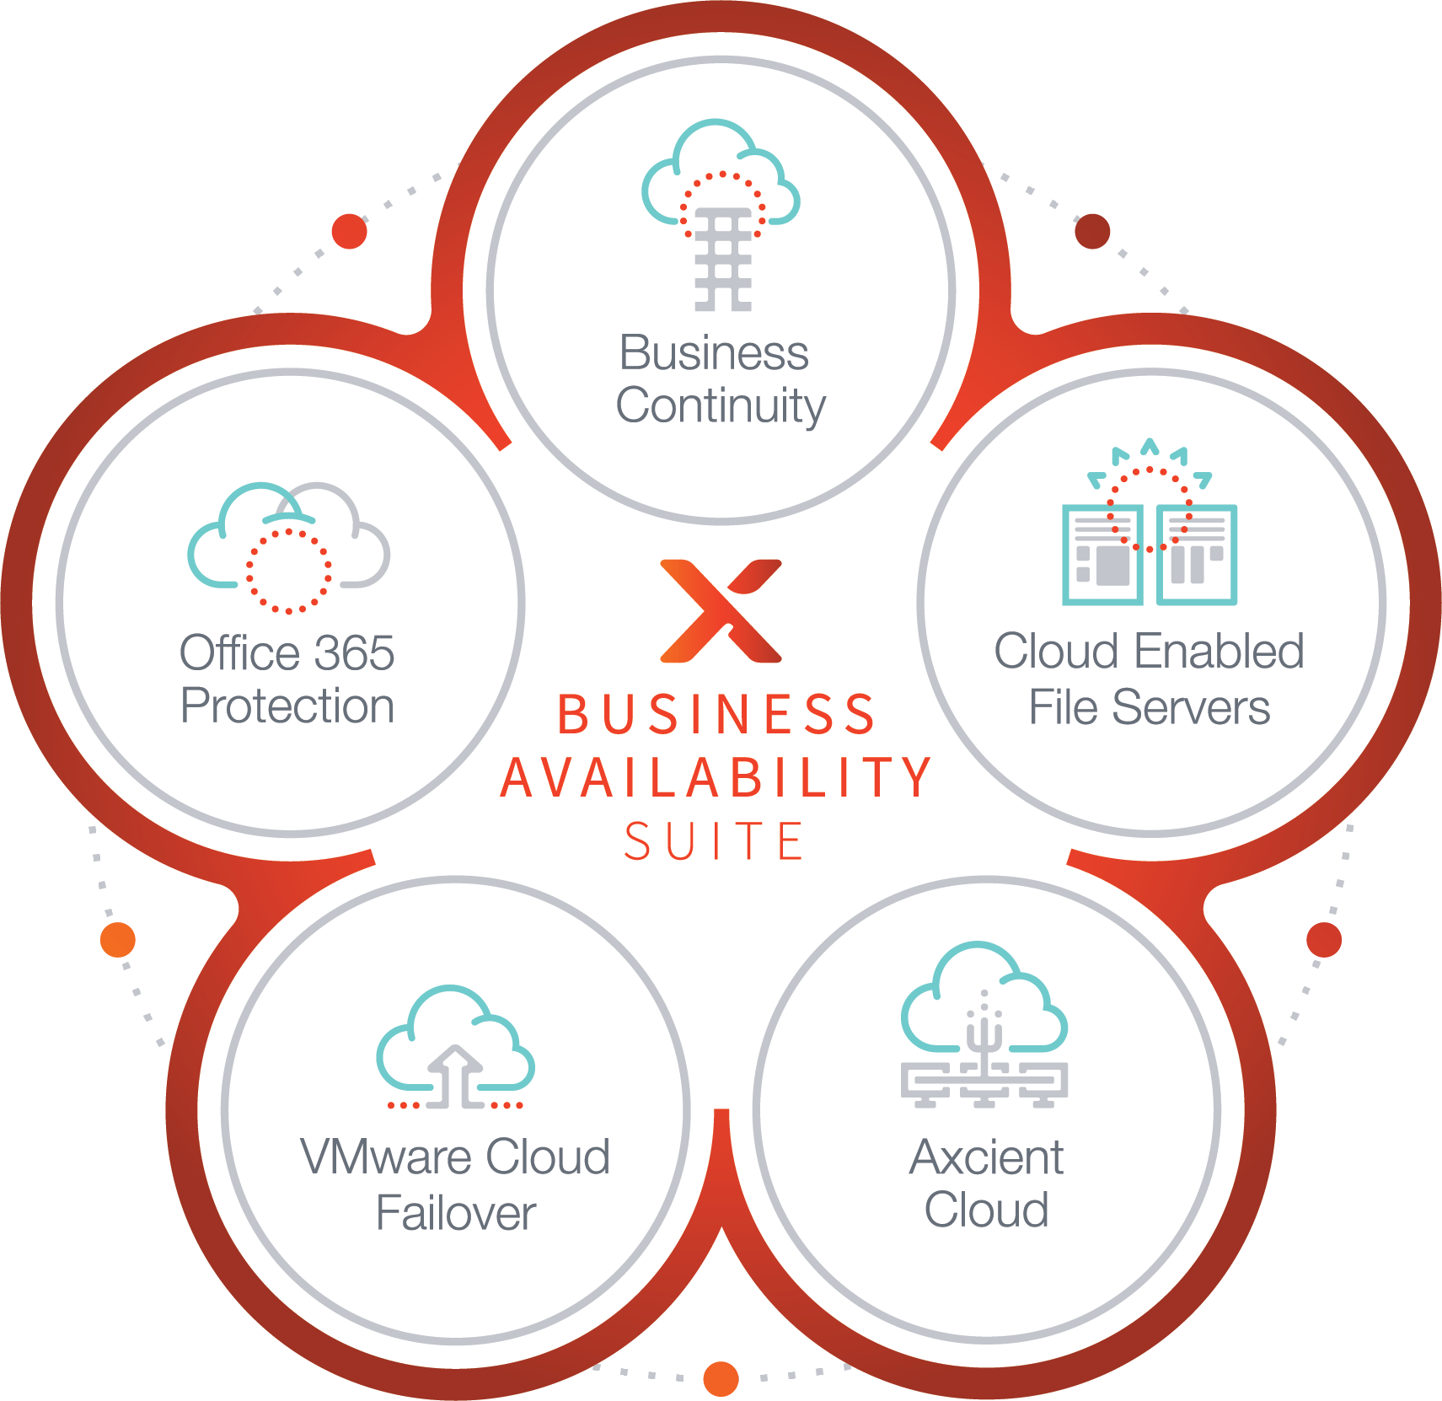
Protect
Everything.

Slide 3
Architecture Overview of our Four Main Components
APPLIANCE
VAULT
AGENT
GLOBAL MANAGEMENT
PORTAL

Slide 4






Axcient Replibit - Component Detail
Server
Desktop/Workstation
AXCIENT CLOUD
Download from the Axcient Cloud
Local Backup
Disk shipment from
The Axcient Cloud
Cloud Backup/Replication
BDR Appliance
Recover in Axcient Continuity Cloud
Vault to Yourself
Recover in your own cloud

Slide 5
Axcient Replibit – Chain-Free Technology Differentiator
Chain-free Backup™ Technology
No base image or chains to corrupt
No redundant copies of data
No synthetic files or rollups
No requirement to reseed the data centre

Slide 6
Axcient Replibit - Backup & Recovery Key Differentiators
BACKUP
RECOVERY
Onsite and offsite Virtualization
Simple, quick file restores
Export VM’s and BMR to dissimilar hardware
eFolder Cloud or host your own Vault
Block level, encrypted Image
Customizable historical backup retention
Absolutely no dependent backup chains or
chain rollups
No reboot after agent install

Slide 7
Axcient Replibit – Different by Design
Replibit Wrote/Owns the Code
No Third Party Software
    (Windows, VMWare, SC)
Auto Updates Pushed to Appliance, Vault and Agents
ConnectWise Integration
    Thoughtful, Automation in mind
    Auto open, append and closes tickets

Slide 8
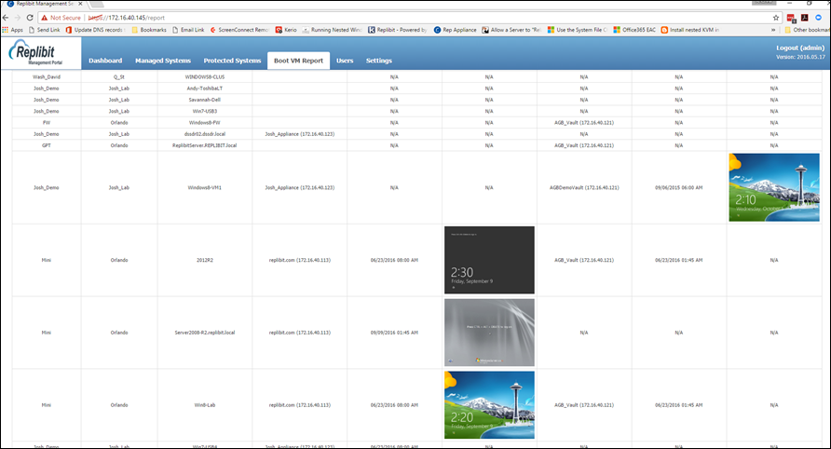

Axcient Replibit - Elegant and Manageable

Slide 9

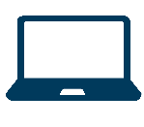
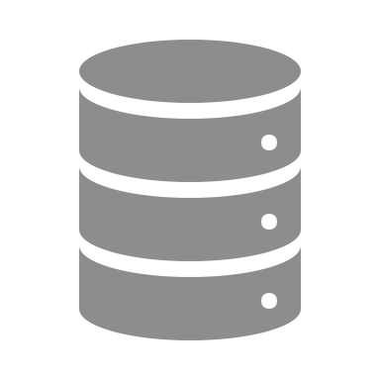
Axcient Continuity Cloud
Recovery in the eFolder Continuity Cloud
Publicly Available Servers
(e.g. HTTP(S), Exchange, SMTP, POP)
Client Location
Private
Virtual
Firewall
Virtualized
Servers
Internet
PPTP tunnel
RDP Management
Axcient Storage Cloud
Axcient Continuity Cloud
Compute Nodes
Node Size | Cores | RAM | Usable Storage | IP addresses | Wholesale Price
Small | 4 CPU cores | 32 GB RAM | 1.7 TB | 1 | $125/week
Medium | 12 CPU cores | 64 GB RAM | 3.4 TB | 1 | $250/week
Large | 16 CPU cores | 192 GB RAM | 13 TB | 3 | $625/week

Slide 10
Axcient Replibit –
Flexible & Powerful Storage Solutions
  eFolder allows for BYOD – Bring your own Device
  The second option is that you can actually order prebuilt, and completely preconfigured devices from Axcient, and we will ship them to you completely ready to go!
 | Nano | Mini (Hybrid) | Pro (Hybrid) | Rack (Hybrid)
Storage Capacity | 500 GB – 2 TB | 1 – 4 TB | 6 - 30 TB | 6 -36 TB

Slide 11
Thank You For Your Time.

